Slide 1
DATABASE SYSTEMS ENGINEERING AND DISTRIBUTED BACKEND DEVELOPMENT (25CS1302E)
Project Review — 2
Online Learning
Management System
Sec No: 10 Team No: 27
Venkat Siddharth Reddy Moku (2520090026)
Sai Saketh Vutharavalli (2520090055)
Y25 · 2026-2027 · Trimester 4

Slide 2

Problem Statement
Traditional classroom-only learning does not scale to large numbers of students.
1
Instructors have no real-time visibility into student engagement or progress.
2
Most existing LMS tools are rigid, with little live interaction between students and instructors.
3
Students lack a single, verifiable record of what they have learned and completed.
4
Team 7 · Section 10 · Online Learning Management System
2

Slide 3

Objectives
Deliver a complete e-learning platform with course authoring, video streaming, assessments, and progress certification.
✓
Enable instructors to author and publish structured courses
✓
Track individual student progress toward certification
✓
Deliver reliable, scalable streaming of video lectures
✓
Support real-time discussion between students and instructors
✓
Provide quizzes and assignments to assess learning
✓
Give administrators visibility through usage analytics
Team 7 · Section 10 · Online Learning Management System
3

Slide 4

Proposed System
A unified platform connecting instructors and learners — from course creation to certified completion.
Instructor
Creates Course
Student
Enrolls & Learns
System
Assesses & Tracks
Student
Earns Certificate
Built as a full-stack web application: React.js front end, Node.js/Express back end, MySQL database.
Media (recorded lectures) is stored and streamed from AWS S3; Socket.io powers live discussion.
Replaces disconnected tools with one system covering authoring, delivery, assessment and certification.
Team 7 · Section 10 · Online Learning Management System
4

Slide 5







System Architecture
Client
API Server
Database
React.js SPA
(Browser)
Node.js + Express
JWT Auth
MySQL
(Relational Data)
AWS S3
JWT
Socket.io
Video lecture storage
Role-based authentication
Real-time discussion forum
Three-tier architecture: presentation, application logic, and data — with cloud storage and real-time messaging as supporting services.
Team 7 · Section 10 · Online Learning Management System
5

Slide 6

Modules / Functionalities
1
2
3
4
User & Role Management
Course Builder
Video Lecture Streaming
Quiz & Assignment Engine
5
6
7
Progress Tracking & Certificates
Discussion Forum
Admin Analytics
Team 7 · Section 10 · Online Learning Management System
6

Slide 7

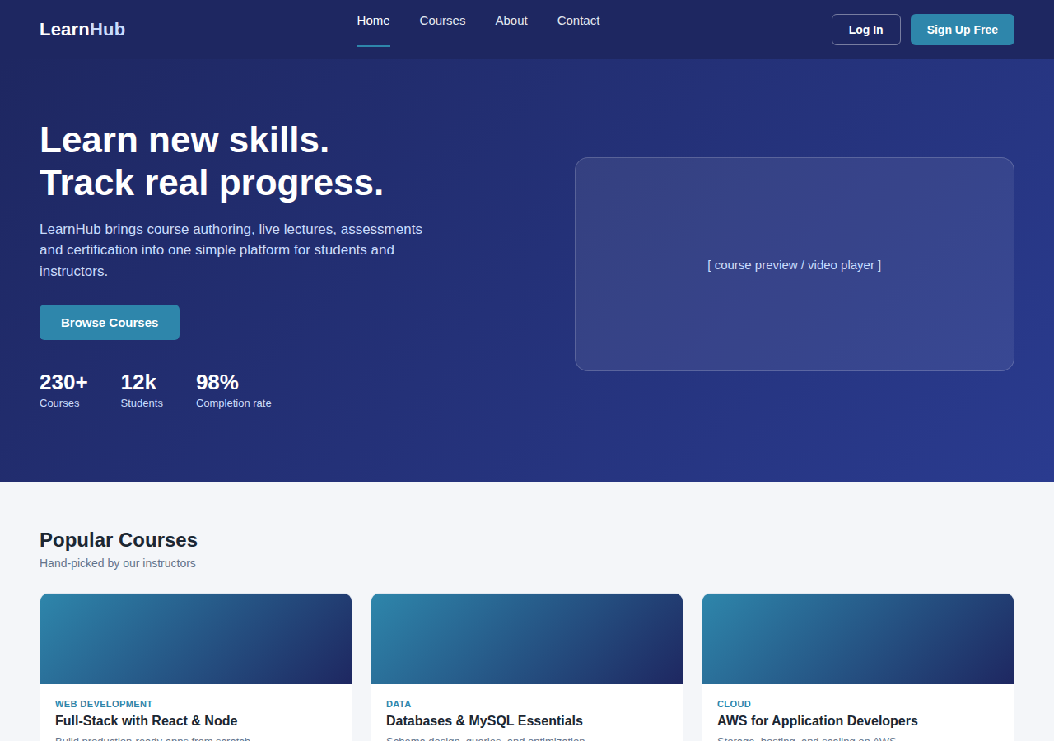
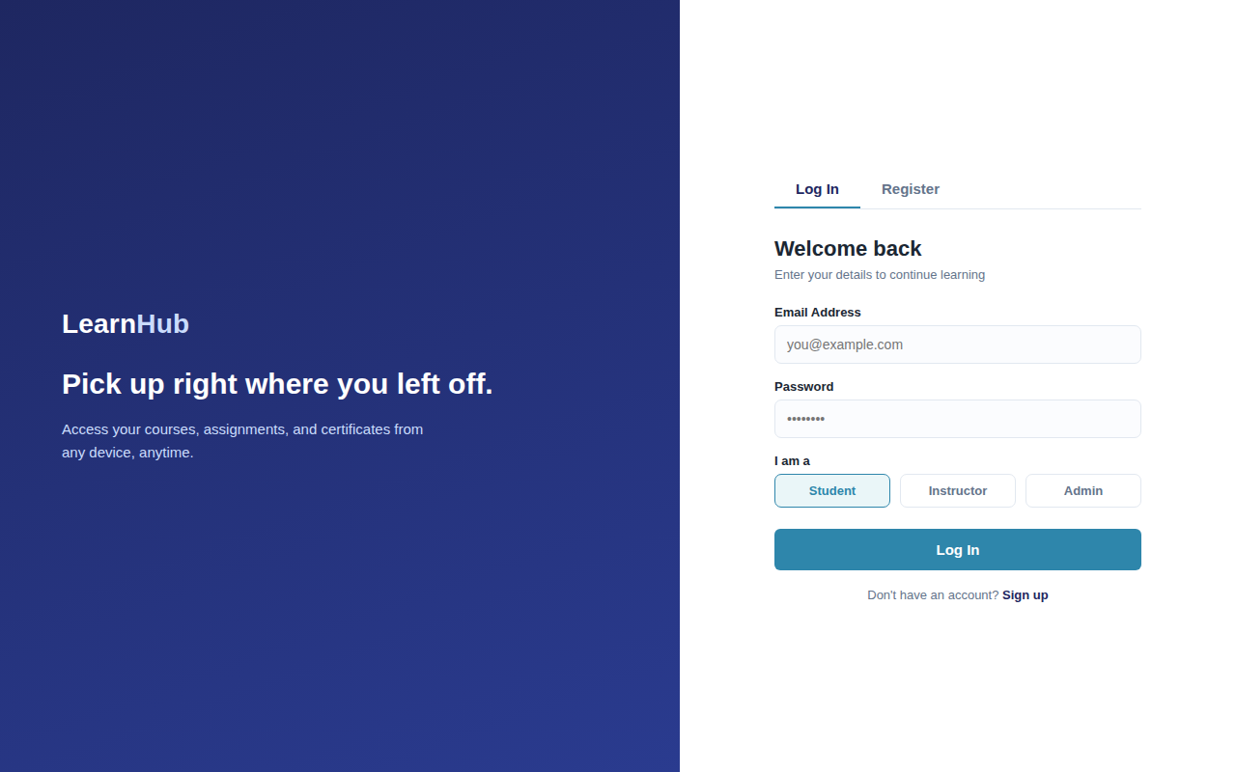
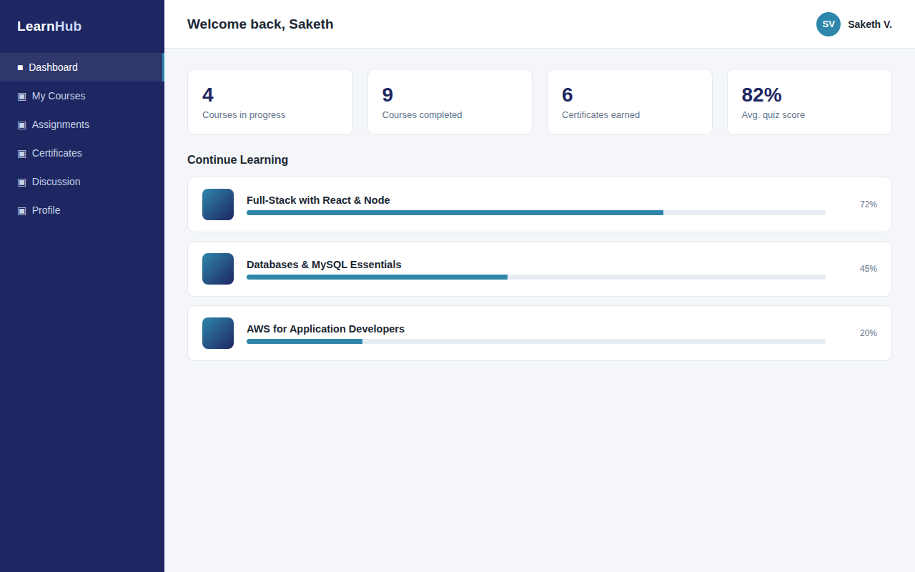
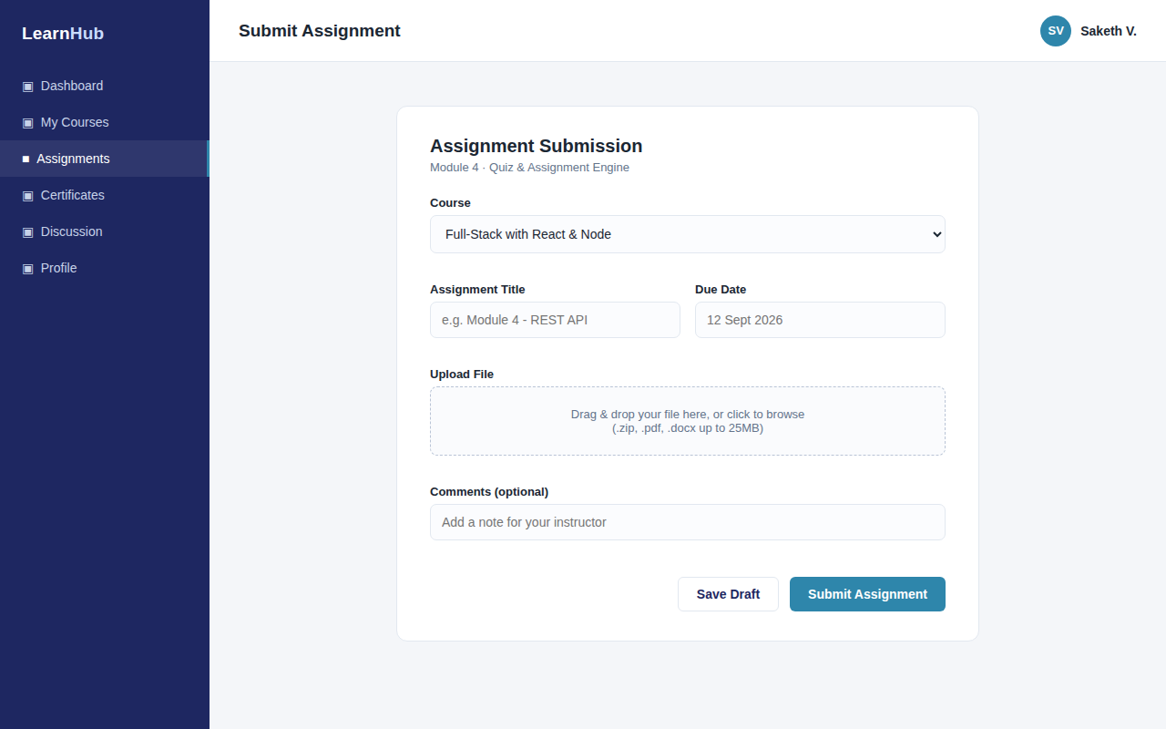
Frontend Design
Planned screens: Home, Login / Registration, Dashboard, and Forms
Home Page
Login / Registration
Student Dashboard
Assignment Form
Team 7 · Section 10 · Online Learning Management System
7

Slide 8

Frontend Implementation — Screenshots
Working prototype screens implemented so far
Login Screen
Student Dashboard — course progress overview
Assignment Submission Form
Team 7 · Section 10 · Online Learning Management System
8

Slide 9

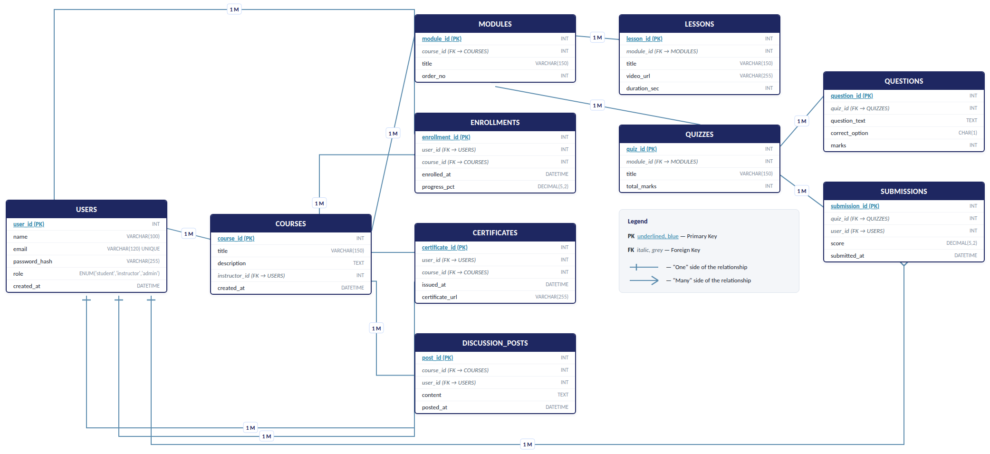
Database Design — ER Diagram
Team 7 · Section 10 · Online Learning Management System
9

Slide 10

Database Tables / Schema
Table | Key Columns | Purpose
USERS | user_id (PK), name, email, role | Stores students, instructors, admins
COURSES | course_id (PK), title, instructor_id (FK) | Courses authored by instructors
MODULES | module_id (PK), course_id (FK), title | Sections within a course
ENROLLMENTS | enrollment_id (PK), user_id (FK), course_id (FK) | Links students to enrolled courses
QUIZZES | quiz_id (PK), module_id (FK), total_marks | Assessments within a module
SUBMISSIONS | submission_id (PK), quiz_id (FK), user_id (FK), score | Student quiz attempts
Team 7 · Section 10 · Online Learning Management System
10

Slide 11

Sample Database Records
Illustrative rows from the USERS and ENROLLMENTS tables
USERS
ENROLLMENTS
user_id | name | email | role
1001 | Venkat Siddharth | venkat@lms.edu | instructor
1002 | Sai Saketh | saketh@lms.edu | student
1003 | Ananya Rao | ananya@lms.edu | student
enrollment_id | user_id | course_id | progress
1 | 1002 | 201 | 72%
2 | 1002 | 204 | 45%
3 | 1003 | 201 | 90%
Note
Records shown are representative test data used to validate schema relationships.
user_id in ENROLLMENTS references USERS; course_id references COURSES.
Live data will be captured once the enrollment and progress-tracking modules are connected end to end.
Team 7 · Section 10 · Online Learning Management System
11

Slide 12

Current Progress
Completed
Project abstract and scope finalized and approved
System architecture and technology stack finalized
Database schema designed across 6 core tables
Frontend page designs completed for all key screens
Authentication flow (JWT) designed for 3 user roles
Overall Completion
~40%
Team 7 · Section 10 · Online Learning Management System
12

Slide 13

Challenges / Issues Faced
1
Video Streaming Performance
2
Real-Time Sync
Ensuring smooth playback of lecture videos from AWS S3 without buffering on slower connections.
Keeping the discussion forum and progress updates consistent across users with Socket.io.
3
Role-Based Access
4
Schema Design Trade-offs
Designing a clean JWT-based permission model for student, instructor, and admin roles.
Balancing normalization with query performance for progress tracking at scale.
Team 7 · Section 10 · Online Learning Management System
13

Slide 14

Future Work
1
Connect frontend screens to live REST APIs
4
Integrate Socket.io for the live discussion forum
2
Implement video upload pipeline to AWS S3
5
Generate downloadable PDF certificates on completion
3
Build the quiz engine and auto-grading logic
6
Conduct end-to-end testing before final review
Team 7 · Section 10 · Online Learning Management System
14

Slide 15
Conclusion
The Online Learning Management System addresses real gaps in scale, visibility, and flexibility left by traditional and existing LMS tools.
Architecture, database schema, and frontend design are complete; core modules are in active development.
The platform is on track to deliver a fully working, demo-ready LMS by the final review.
Thank you

